Slide 1
Speech time
Alanah Sarginson
Noémie Claret
Len Metson
This presentation will discuss the analysis of our data and the ideas we have for our final product.

Slide 2
analysis

Slide 3
Data wrangling
PROBLEMS WITH THE DATA
Asymmetric duplication in the speeches
Speeches doubled but order no. is a running variable
This meant we had to reshape the data so as to remove duplicated speeches

Slide 4
Gender and speeches Gender and syllables
Image placeholder
The sylcounts packages returns and estimate of the number of syllables in a vector of words
However, the output is a vector. For example, the output for the sentence "I disagree with you" would have the output c(1, 3, 1, 1)
However, we need an estimate the sum of syllables in a speech
We used the lapply function to sum the vectors for each speech

Slide 5
Gender and speeches Gender and content
The basis of our analysis is that this question is important because women being able to speak in legislative settings means women will be more represented. This claim gets complex when we get into the political science of representation and especially representation based on group characteristics. Further, better specified analysis would be needed to test this assumption legitimately. However, just for illustration purposes we did a very basic dictionary content analysis to see if female MSPs did talk more about women.
This was done using string matching. First we cleaned the data by making it all lower case and removing punctuation marks. We then applied a string matching function using the library stringr which returned a numeric binary for whether a match was found:

Slide 6
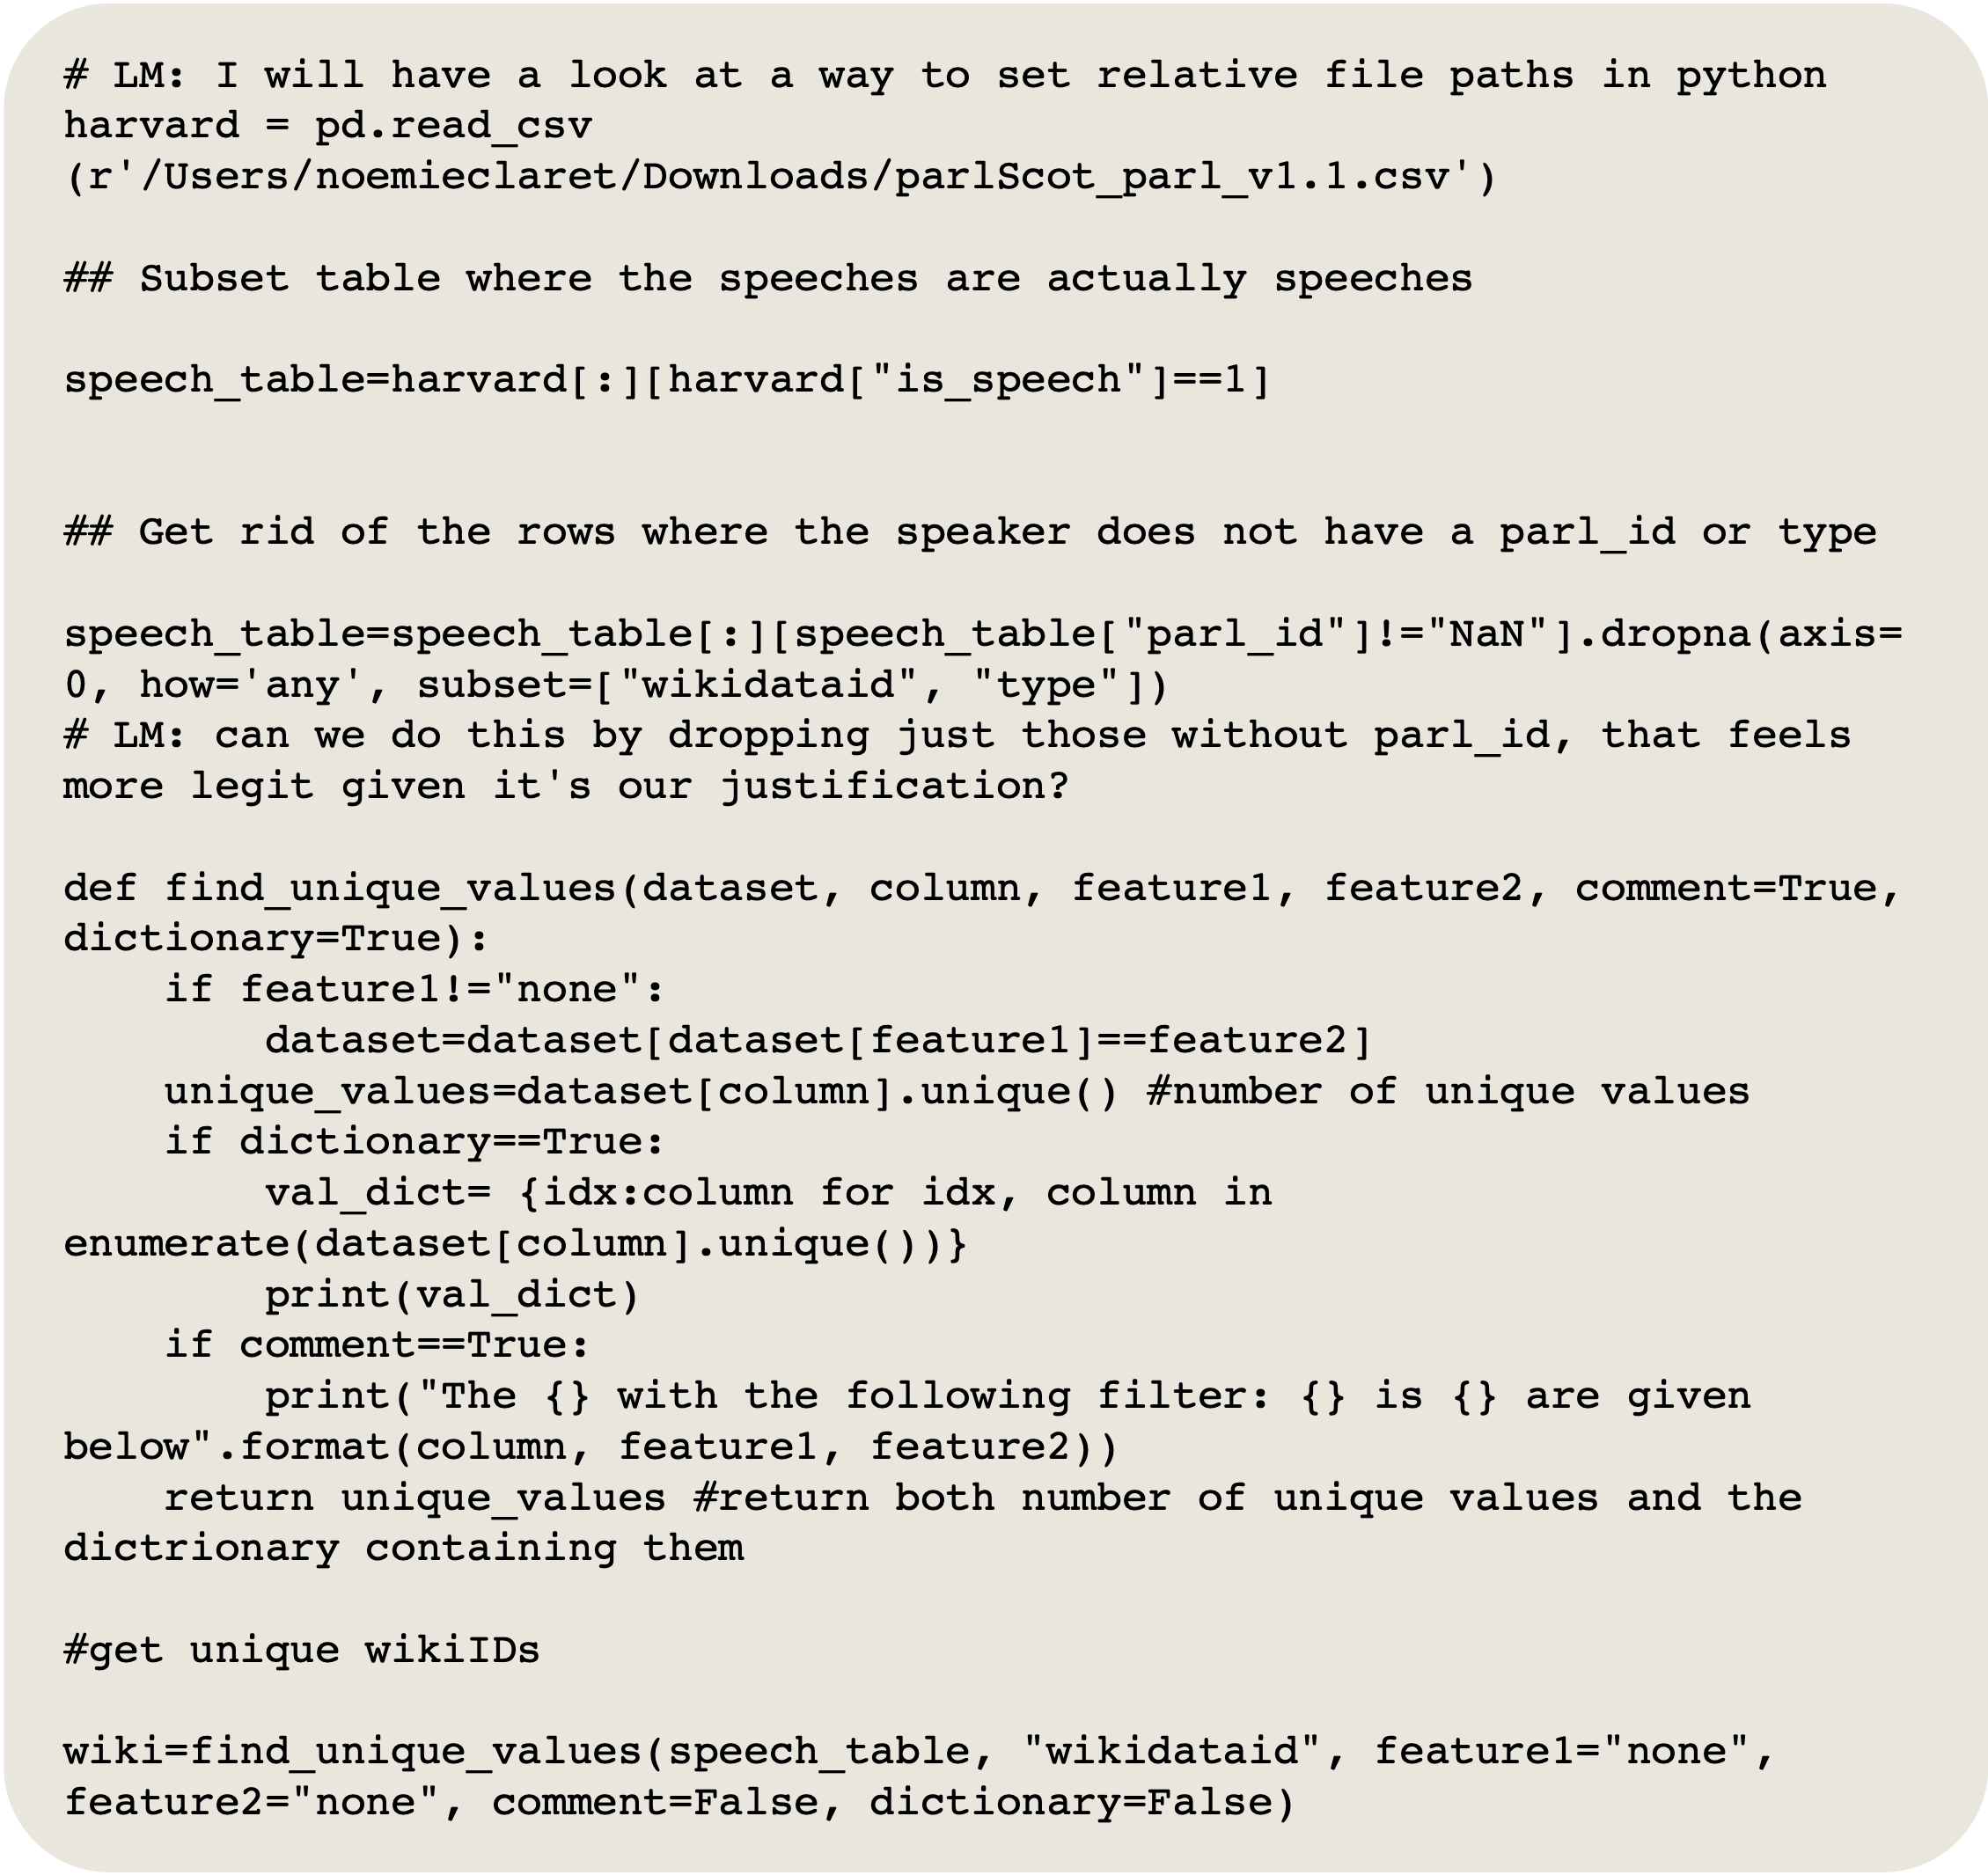
More variables Wiki API
To see if we can extract any meaningful insight relating speech time and women's age, we need to find the date of birth for all MSPs in our data. We have tries multiple approaches for this. First, we used the web-scraping approach to obtain birth date data (which can have many forms, i.e., strings, year, tuple) from the Wikipedia infoboxes.
For this, we first created a list with all distinct WikiData ID present in to dataset

Slide 7
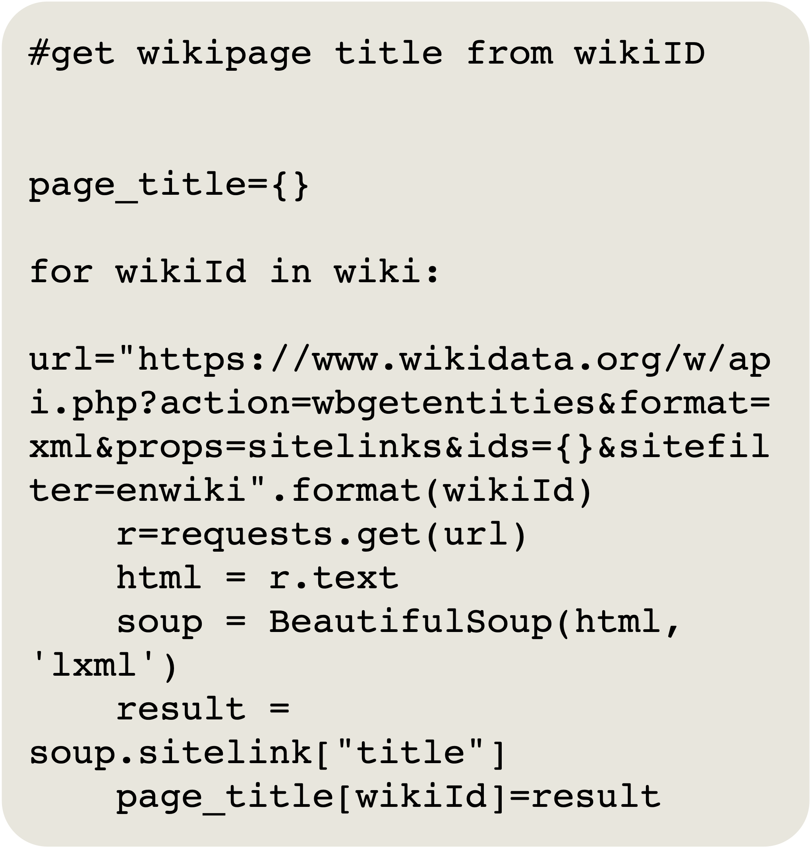
More variables Wiki API
We then iterated through this list to and made an https request (using the python requests library) to the WikiData API to get the corresponding page title for each WikiData ID. This is incorporated in the request by using the string formatting method embedded in the hardcoded URL. SPARQL= query language to retrieve data stored in RDF (resource description framework) format. We parse through the resulting html using BeautifulSoup to get the page title, and appended this to a dictionary.

Slide 8
More variables Wiki API
age_data=[]
urls=[]
for i in page_title.values():
search_sug=wikipedia.search(i, suggestion=False)
for j in search_sug:
if j==i:
url_=wikipedia.page(j, auto_suggest=False).url
urls.append(url_)
print(urls[0:5])
We then used the python Wikipedia library with the search, page and URL modules to iterate though page suggestions, find the one that corresponded to the right MSP and get the corresponding URL.

Slide 9
More variables Wiki API
for url in urls:
html = urlopen(url)
soup = BeautifulSoup(html, 'html.parser')
left=soup.find_all("th", class_="infobox-label")
for left_element in left:
if left_element.text=="Born":
datawewant=left_element.find_next_sibling("td").text
age_data.append(str(datawewant))
else:
age_data.append("not found")
Now that we have the correct URLs, we can parse through the infobox HTML and get the information corresponding to the "born" row. But if there is no such row, we ask the algorithm to add "not found" to the list of date of birth information.

Slide 10
More variables Wiki API
And finally, we extract the year from the "born" data where it is available using the re library.
born_year=[]
for i in age_data:
if i=="none":
born_year.append("none")
else:
year=re.match(r'.*([1-3][0-9]{3})', i).group(1)
born_year.append(year)

Slide 11
More variables Wiki API
However, the ouput is excessively poulated with "not found" data, as most of the MP's wikipedia pages either do not have infoboxes or do not have data avilable for their birth year.
This is why we will try a different, more systemic approach by querying the wikidata service directly (in python). We are currently getting acquatined with SPARQL, a querying language for data stored using Ressource Description Framework method. One challenge is that it is easy to select data that matches triple property, but not to directly read the date of birth value for a given wikidata page, since this data is not structured. The easy way out is to parse through the html once more,

Slide 12
Findings

Slide 13
Gender and gender focus

Slide 14
More detailed background

Slide 15
Final product

Slide 16
Loading summary statistics data
We now have data we can work with in the speech-time/output_data folder in our GitHub repository
This includes the .csv file summary_year.csv, that included yearly, gender-separated data on:
Number of MSPs who spoke
Number of syllables spoken
Number of speeches
Proportion of women-focused speeches
We decided on separating the data on years rather than parliaments so as to provide a continuous axis in the product rather than discrete
This way, we can introduce the discrete dimension of parliamentary sessions as marks on the visualisation
This data was then downloaded on a local machine, to be connected to in Tableau Public as a text file

Slide 17
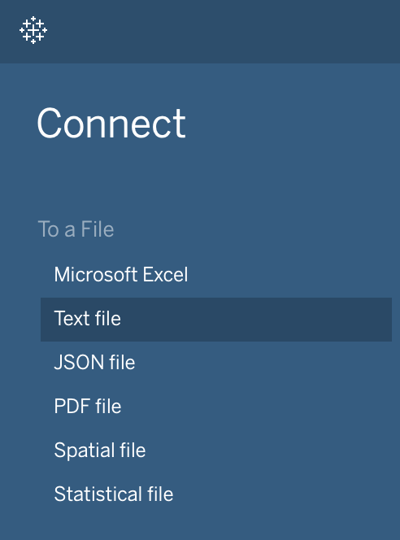
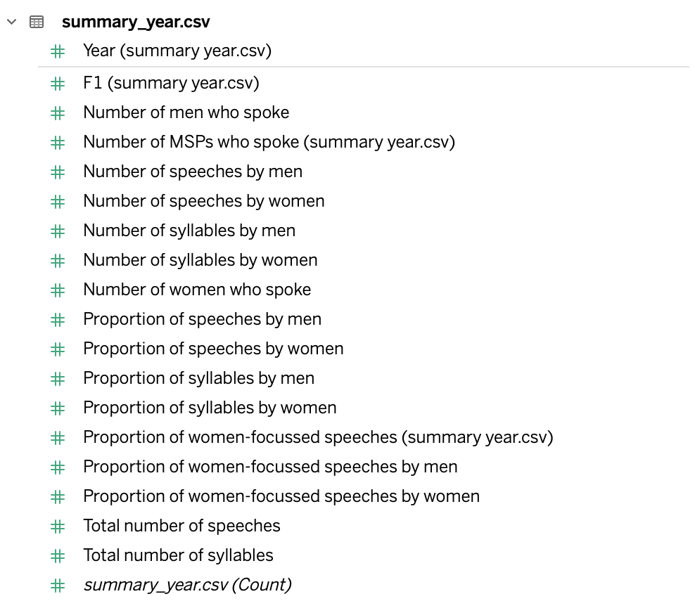
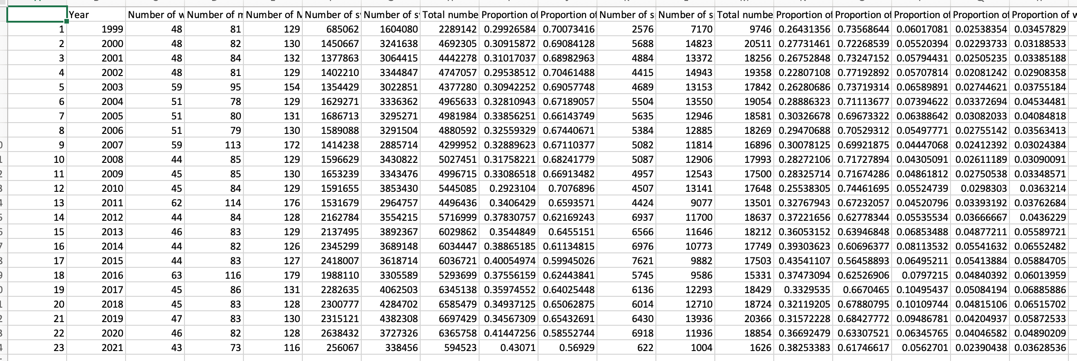
Loading summary data / dimensions and measures
Once we connected the file, dragged the sheet to the workspace and created the relevant worksheet, a problem had quickly been made apparent in how we had labelled our data
We had differentiated gender via the columns, instead of inputting them as discrete values in rows in a specific gender-dimension column What this had meant is that gender wasn't recognised as a dimension holding two discrete values (men/women)
The solution to this problem was creating a way to successfully separate years and gender as dimensions
We decided to stick to making changes to the '.csv' on the local machine, before translating the changes to the R code that produced the output data and its respective columns/rows

Slide 18
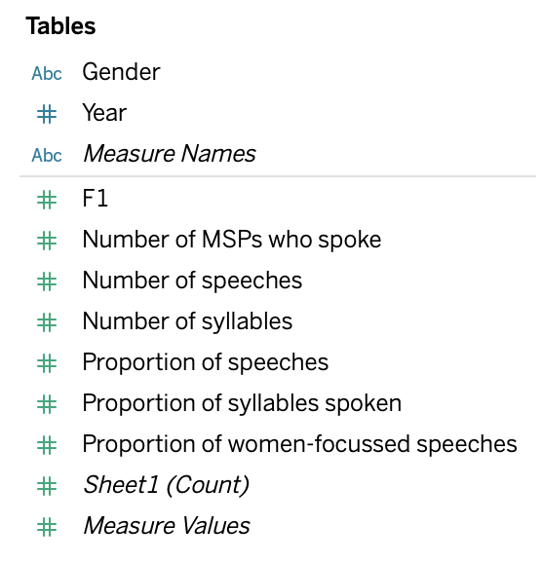
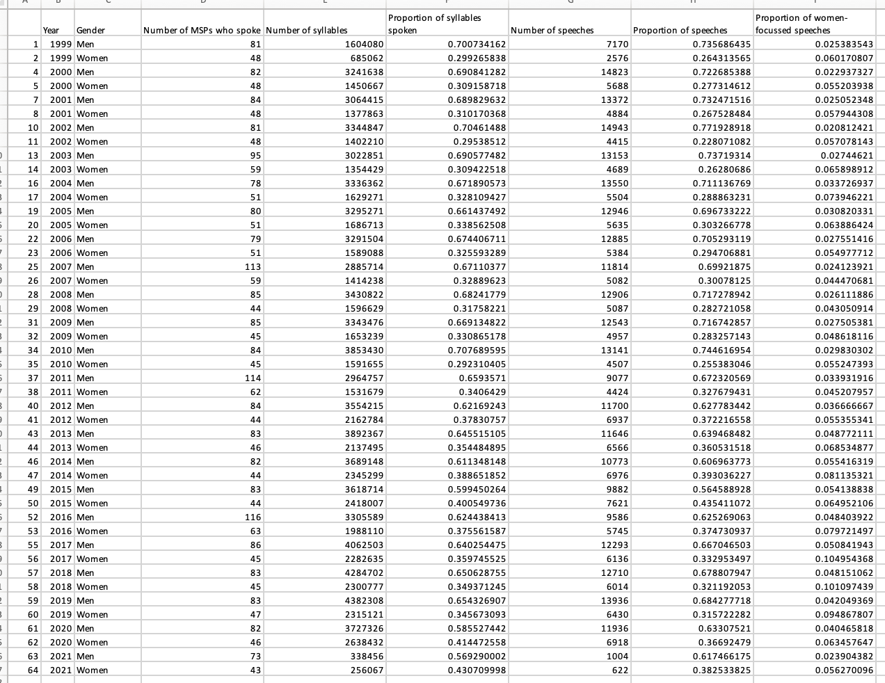
Loading summary data / dimensions and measures
As such, we created a new column - 'Gender' - and separated the values between this new dimension
This created two rows for each year - one for men, and one for women
The result was a much tidier table in Tableau, translating to an easier and more efficient way of exploring and visualising the data through its better-defined dimensions and measures

Slide 19
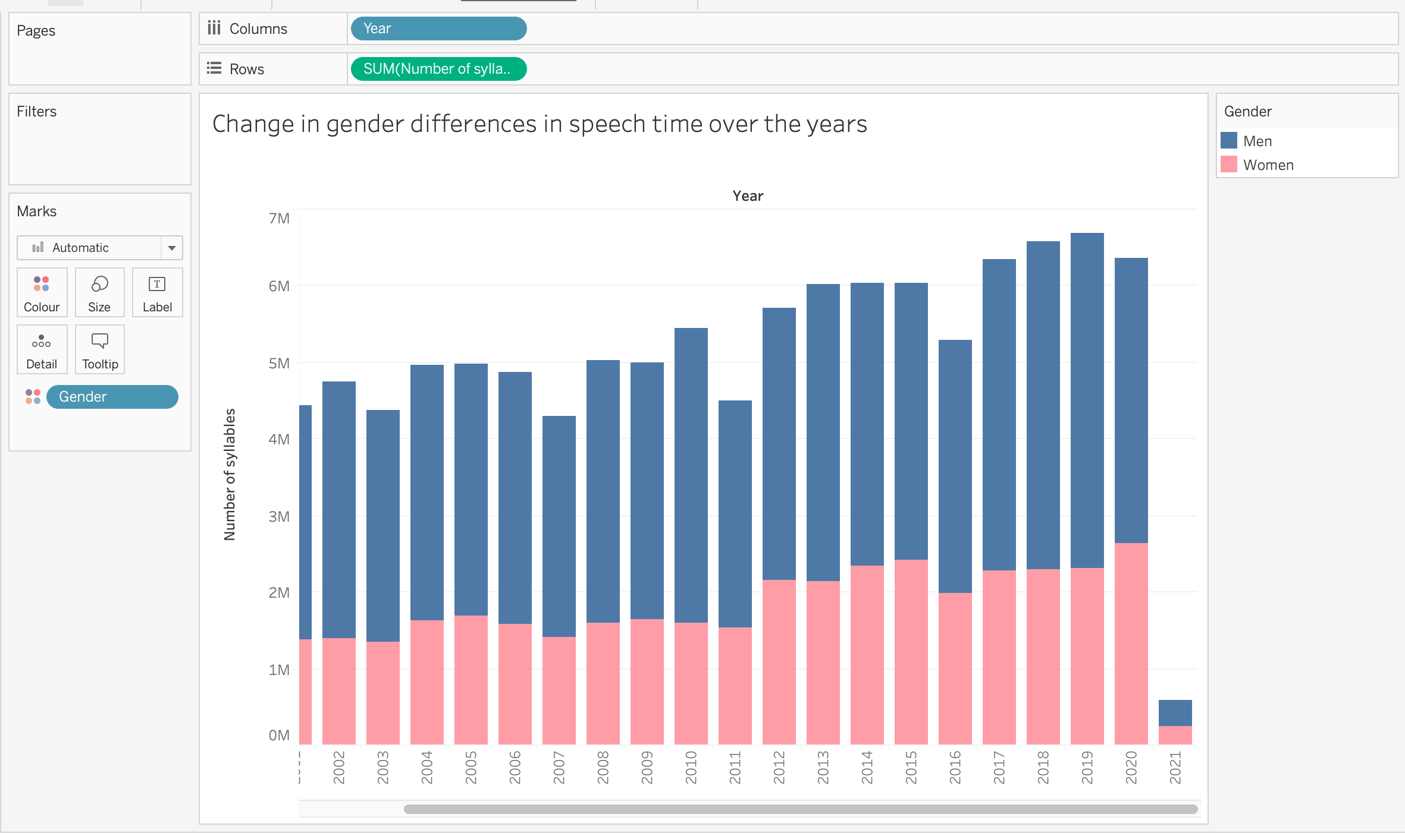
Building the visualisation - example
The first visualisation looked at the changes in gender differences of speech time over the years. We planned to represent data on syllable count using a stacked column graph.
We first set our column as our years
We then set our rows as the sum number of syllables spoken each year
We next wanted to visually differentiate how the genders differ in this measure, so did so by attributing gender to a colour mark, editing the colourway to represent more 'gender-representative colours' We believed the stacked bar chart best represented two elements of our investigation:
The dominance men have in speaking in parliament over the years
The changing picture as women are speaking more in parliament

Slide 20
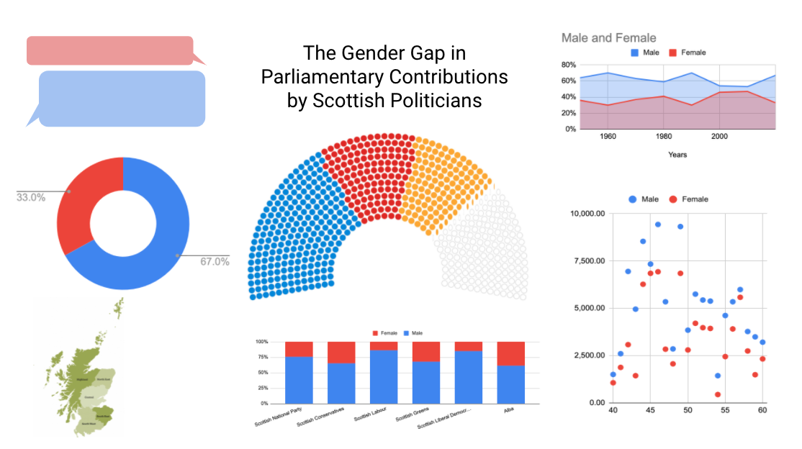
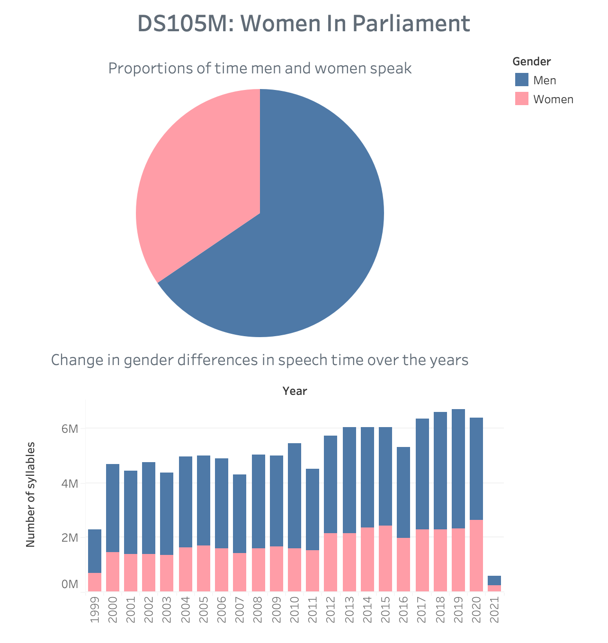
Building the dashboard
We anticipate the final product as a centralised dashboard hosting:
All of the different visualisations
Text detailing our aim, process, results and conclusions, as well as our header and an overview of the project
Links to the data sources that we have used
The first screenshot is the rough visual layout that was proposed at the start of the project, and the second is an example using two initial visualisations so far of how such the dashboard would function on Tableau

Slide 21
Next steps Segmenting by term
One key step will be segmenting by term
One way to do this could be to edit the '.csv' directly and create a separate column called 'Parliamentary session', and using the table in Slide 2.1 to label the rows accordingly. This would then create a discrete dimension which would be applied to visualisations
Another potential way to do this is by using the 'Filter' function to filter the visualisations by certain time-frames - although this avenue hasn't been fully explored yet

Slide 22
Next steps Applying visual best practices
Another important step is applying visual best practices to tell the story: this is an exciting opportunity to conduct independent research and explore how the data viz. community are presenting their data
This will be of a particular challenge for visualisations whose graphs are non-conventional, for example using the Scottish parliamentary seat map to show the power in parliament by amount of seats taken up once gender differences in speech time are considered

Slide 23
Next steps Interactive opportunities
Lastly, we'll be building interactive elements into the dashboard by using filters to allow the user to explore the data themselves
Returning to the table from our previous presentation, a learning so far has been the importance of being clear on what specific data is needed and how it needs to be presented to communicate the intended message, so that the process of extracting, cleaning, exporting, connecting, and ultimately visualising the data is streamlined

